Slide 1
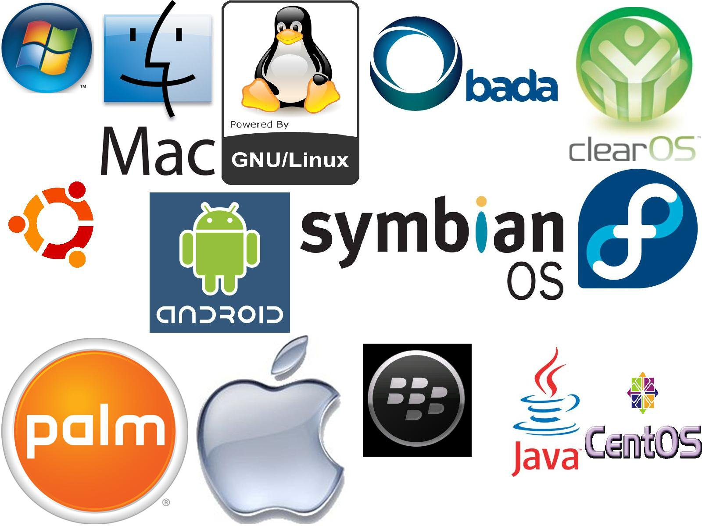
Distributed Operating system
Er. Deeyoranjan Dongol

Slide 2
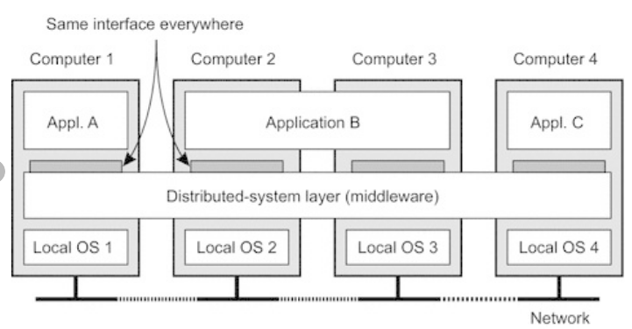
Distributed System
Software system in which components located on networked computers communicate and coordinate their actions by passing messages to achieve some common goal
Distributed Operating System
An operating system that runs on several machines whose purpose is to provide a useful set of services generally to make the collection of machines behave more like a single machine
Examples: Windows server 2003, Ubuntu

Slide 3
Advantages of Distributed System
Unlimited Horizontal Scaling
Low Latency
Fault Tolerance
Better Price/Performance Ratio
Efficient Speed
Data Sharing
Disadvantages of Distributed System
Data Integration & Consistency
Network & Communication Failure
Management Overhead

Slide 4
Characteristics of Distributed System
Resource Sharing
Scalability
Openness
Distributed System Characteristics
Fault Tolerance
Concurrency
Transparency

Slide 5
Characteristics of Distributed System
Resource Sharing
Shares resources like h/w (printers) ,s/w (files, data objects)
Reduces cost
Openness
Extension and improvements
Criteria needed to make distributed system open
Well defined interface of components must be published
Should standardize the interface of components
New component must be easily integrated with the existing components

Slide 6
Characteristics of Distributed System
Concurrency
Multiple activities execute at the same time
Reduces latency and increase throughput of distributed system
Scalability
Concerned with how the distributed system handles the growth as the number of users for the system increases
No components change when we scale (add more computers in the network) the system

Slide 7
Characteristics of Distributed System
Fault Tolerance
Different aged hardware may cause failure
Ability for the system to handle such failures through recovery (Component act in predictable controlled way) and redundancy (crucial system or processes have backup)
Transparency
Idea that user perceives that they are interacting with a whole quantity rather than a collection of cooperating components
Various types:- Access, Location, Concurrency, replication

Slide 8
Advantages of Distributed System over Independent PCs
Data Sharing
Example: Airline reservation
Resource Sharing
Expensive peripherals can be shared
Communication
Electronic mail much faster and secure
Flexibility
Workload can be spread over the computers effectively and loss of few machines can be compensated for letting people run their job elsewhere

Slide 9
Network Operating System
An operating system that is designed primarily to support workstations, personal computers and in some instances older terminals that are connected on a local area network
Run on a server and provides the functionality to manage data, users, applications, security and other networking roles
Examples: Windows Server 2008, Netware
Advantages
Highly stable and centralized
Servers handle security concerns
Disadvantages
Expensive servers
Regular updates and maintenance required

Slide 10
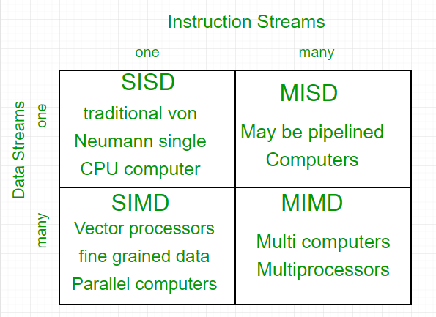
Hardware Concept: Flynn’s Taxonomy
Focused on number of instructions streams and number of data streams

Slide 11
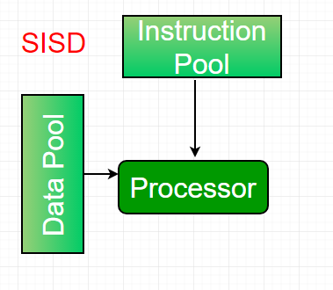
Hardware Concept: Flynn’s Taxonomy
Focused on number of instructions streams and number of data streams
Single Instruction, Single Data Streams
Uniprocessor machine which is capable of executing a single instruction, operating on a single data stream
All the instructions and data to be processed have to be stored in primary memory
Example: IBM PCs, Workstations

Slide 12
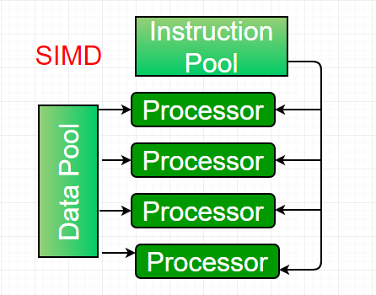
Hardware Concept: Flynn’s Taxonomy
Single Instruction, Multiple Data Streams
Multiprocessor machine capable of executing the same instruction on all the CPUs but operating on different data streams
Example: Cray’s Vector Processing Machine

Slide 13
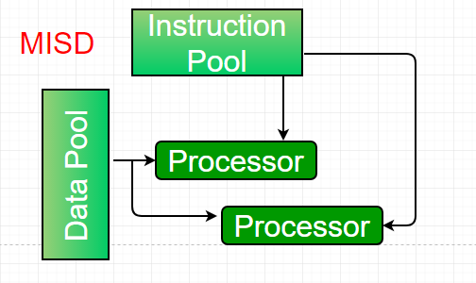
Hardware Concept: Flynn’s Taxonomy
Multiple Instruction, Single Data Streams
Multiprocessor machine which is capable of executing different instructions on different processing elements but all of them operating on same the data sets

Slide 14
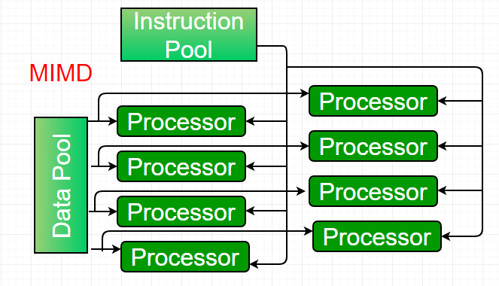
Hardware Concept: Flynn’s Taxonomy
Multiple Instruction, Multiple Data Streams
Multiprocessor machine which is capable of executing multiple instructions on multiple data sets
Each processing element has separate instruction and data streams
Processing elements work asynchronously

Slide 15
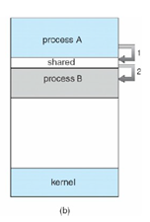
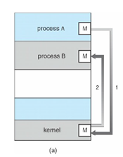
Communication between two processes in a distributed system is required to exchange various data such as code or a file between the processes
Inter Process Communication
Set of programming interfaces that allows a programmer to coordinate activities among different processes that can run concurrently in an operating system

Slide 16
Shared Memory
read(shared_variable)
write(data,shared_variable)
Message Passing
send(destination, &message)
Sends a message to a given destination
receive(source, &message)
Receives a message from a given source

Slide 17
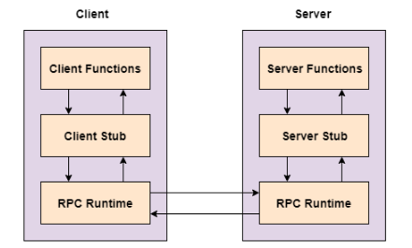
Remote Procedure Call (RPC)
An inter process communication technique that is used for client-server based applications
Also known as a subroutine call or a function call
Notes:
A client has a request message that the RPC translates and sends to the server.
This request may be a procedure or a function call to a remote server.
When the server receives the request, it sends the required response back to the client.
The client is blocked while the server is processing the call and only resumed execution after the server is finished.

Slide 18
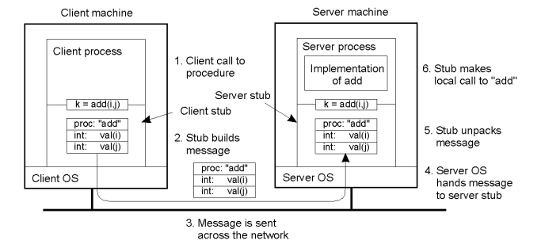
Remote Procedure Call (RPC)
Notes:
A client has a request message that the RPC translates and sends to the server.
This request may be a procedure or a function call to a remote server.
When the server receives the request, it sends the required response back to the client.
The client is blocked while the server is processing the call and only resumed execution after the server is finished.

Slide 19
During RPC following steps take place
The client calls the client stub. The call is a local procedure call with parameters pushed onto the stack in normal way
The client stub packs the procedure parameters into a message and makes a system call to send the message. The packing of the procedure parameters is called marshalling
The client's local OS sends the message from the client machine to the remote server machine.
The server OS passes the incoming packets to the server stub
The server stub unpacks the parameters - called unmarshalling - from the message
When the server procedure is finished, it returns to the server stub, which marshals the return values into a message. The server stub then hands the message to the transport layer
The transport layer sends the resulting message back to the client transport layer, which hands the message back to the client stub
The client stub unmarshalls the return parameters, and execution returns to the caller

Slide 20
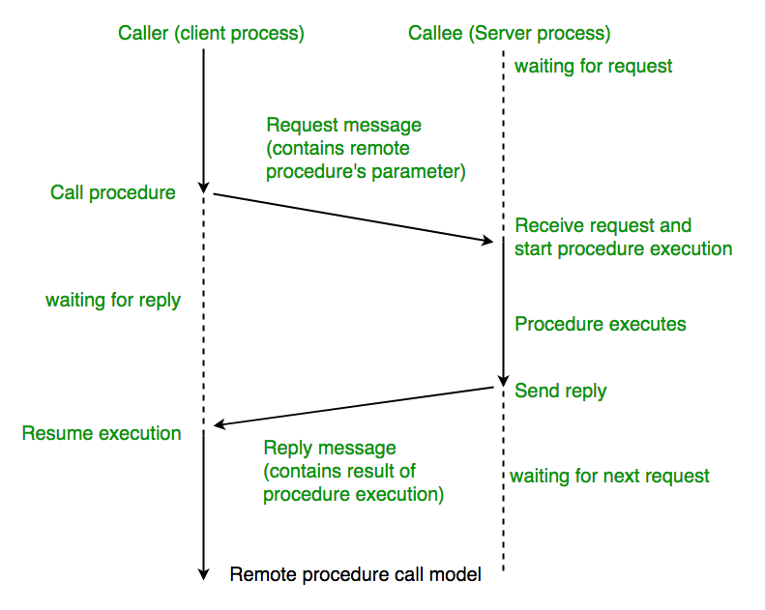
Remote Procedure Call (RPC)
Notes:
A client has a request message that the RPC translates and sends to the server.
This request may be a procedure or a function call to a remote server.
When the server receives the request, it sends the required response back to the client.
The client is blocked while the server is processing the call and only resumed execution after the server is finished.

Slide 21
Clock Synchronization
Not possible to collect all the information about the system in one place and then let some process examine it and make a decision
Achieving agreement on time is not trivial
Properties of Distributed Algorithms
The relevant information is scattered among multiple machines
Process make decisions based only on local information
A single point failure in the system should be avoided
No common clock or other precise global time source exists

Slide 22
Logical Clocks(Timer)
Precisely machined quartz crystal
When kept under tension, quartz crystal oscillates at a well-defined frequency that depends on the kind of crystal, how it is cut, amount of tension
Quartz crystal has two registers
Counter
Holding Register
Working Mechanism
Each oscillation of the crystal decrements the counter by one and when counter gets to zero an interrupt is generated and the counter is reloaded from the holding register
Each interrupt is called one clock tick

Slide 23
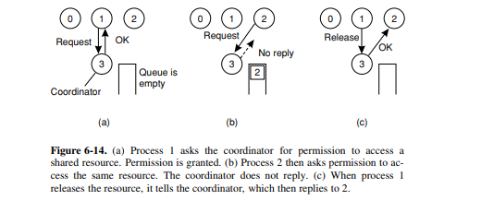
Clock Synchronization Algorithms
Centralized Algorithm
Here on process is selected as coordinator of the system with the authority of giving access to other process for entering the critical region
If any process want to enter the critical region it has to take permission from the coordinator process and this permission is taken by sending REQUEST message

Slide 24
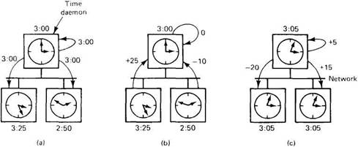
Centralized Example: The Berkeley Algorithm
The time daemon polls every machine from time to time to ask what time it is there
Based on the answers, it computes an average time and tells all the other machines to advance their clocks to the new time or slow their clocks down until some specified reduction has been received

Slide 25
Distributed Algorithm
When a process wants to enter critical region, it builds a message containing: Name of Critical Region, its Process Number and its Current Time and sends this message to all the processes in the network
When another process receives this message, it takes the action pertaining on its state and the critical region mentioned
Three cases are possible
If the message receiving process is not in the critical region and does not wish to enter it, it sends it back
Receiver is already in the critical region and does not reply
Receiver wants to enter the same critical region and has not done so, it compares the timestamp of the incoming message with the one it has sent to others for permission; The lowest one wins and can enter the critical region
When the process exits from critical region, it sends OK message to inform everyone

Slide 26
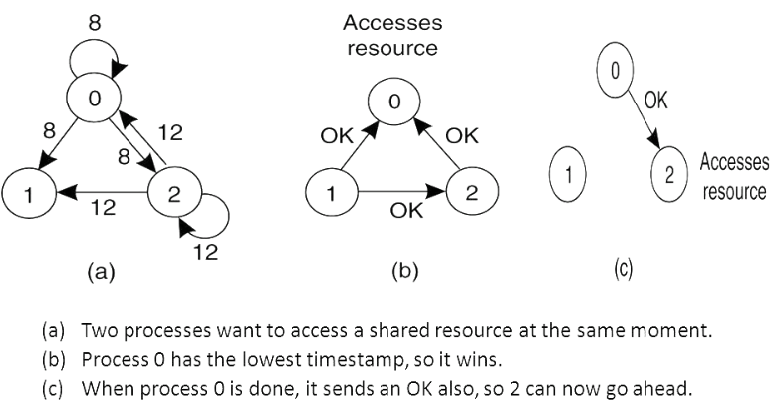
Distributed Algorithm

